Slide 1

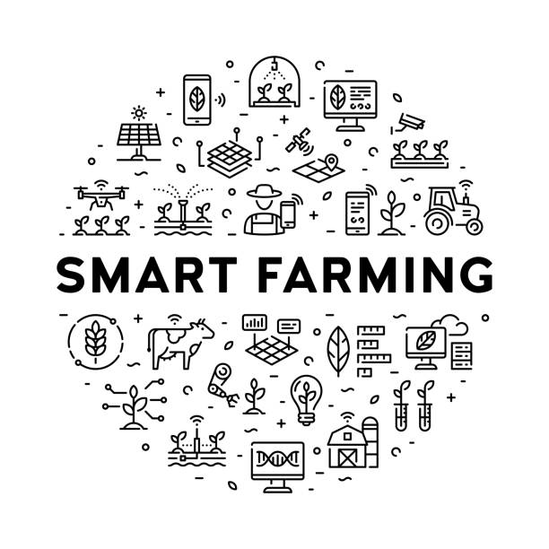
B.Tech External Project Evaluation, VIIIth Sem
PRECISION AGRICULTURE USING IOT SENSORS
Presented by :-
Yashwardhan, 2019003754
Yatharth Negi, 2019620107
AakritiKumari,2019504663
Under the Supervision of:-
( Dr.Sudeep Varshney)
Sharda University, Gr. Noida
DEPARTMENT OF COMPUTER SCIENCE & ENGINEERING
SCHOOL OF ENGINEERING AND TECHNOLOGY
May, 2023

Slide 2
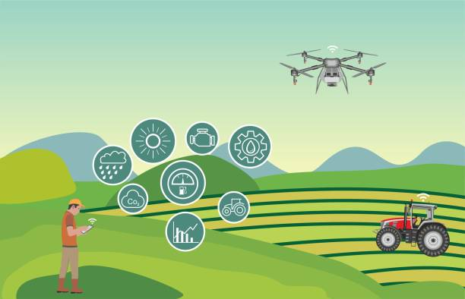
Contents of the Presentation:
Introduction
Motivation
Problem statement
Literature review
Workload distribution
Approval from guide
Features
Proposed architecture
Hardware Used
Working
Results
References

Slide 3
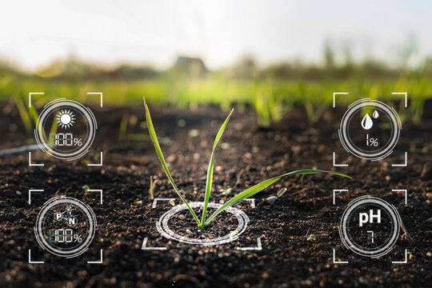
Introduction to the Project
The project aims at making use of evolving technology i.e. IOT and smart agriculture using automation.
Smart agriculture is an emerging concept, because IOT sensors are capable of providing information about agriculture fields and then act upon based on the user input.

Slide 4
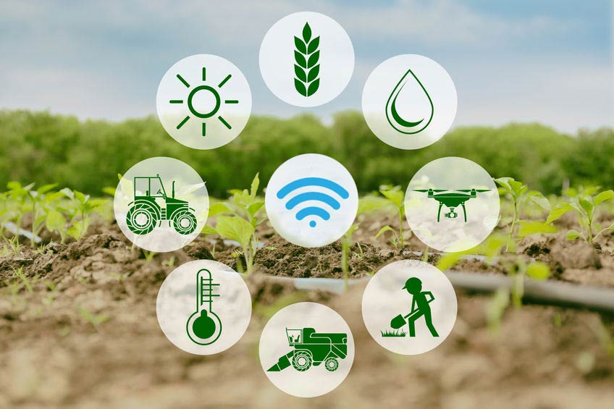
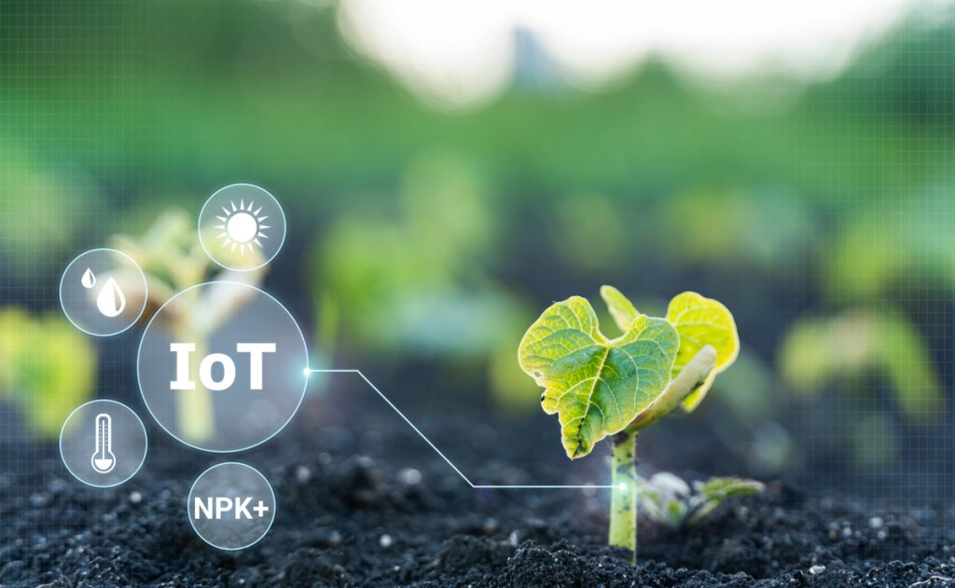
Introduction to the Project
In our project we have, automatic humidity and temperature sensor to measure the temperature and humidity of soil to get the health of soil.
we have also used moisture sensor which automatically detect weather the soil is wet or not .
we have also drastic function of uv light which kills the pests for crops without any harmful chemicals or violent methods

Slide 5
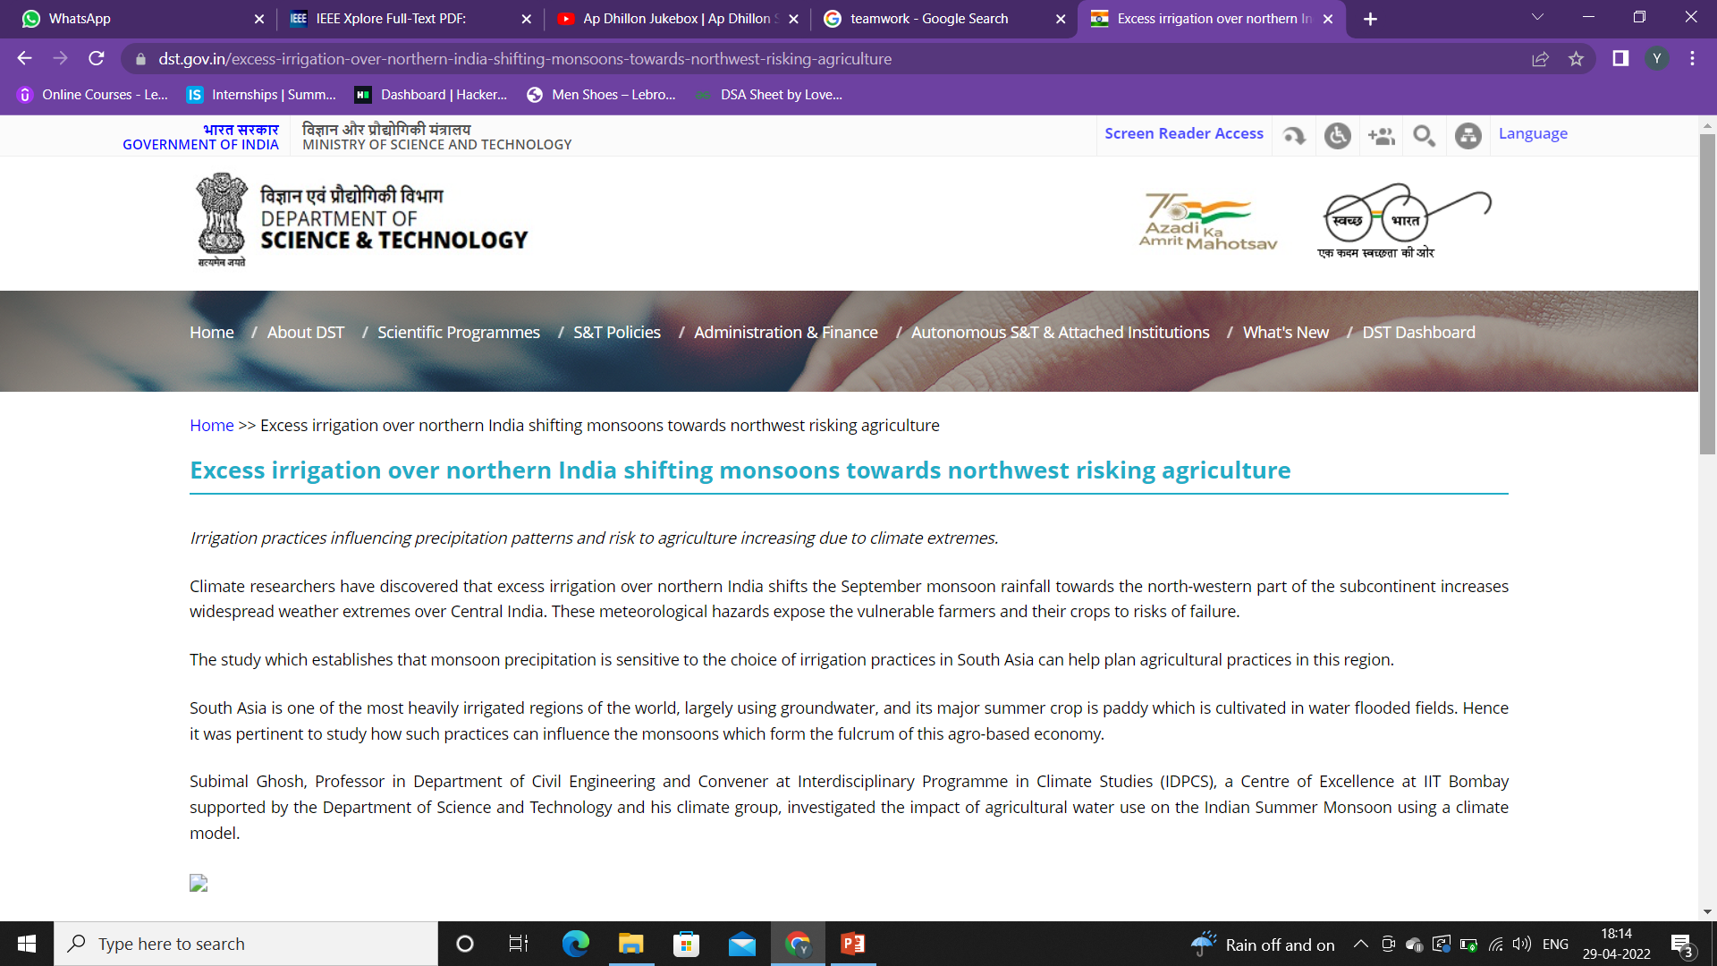
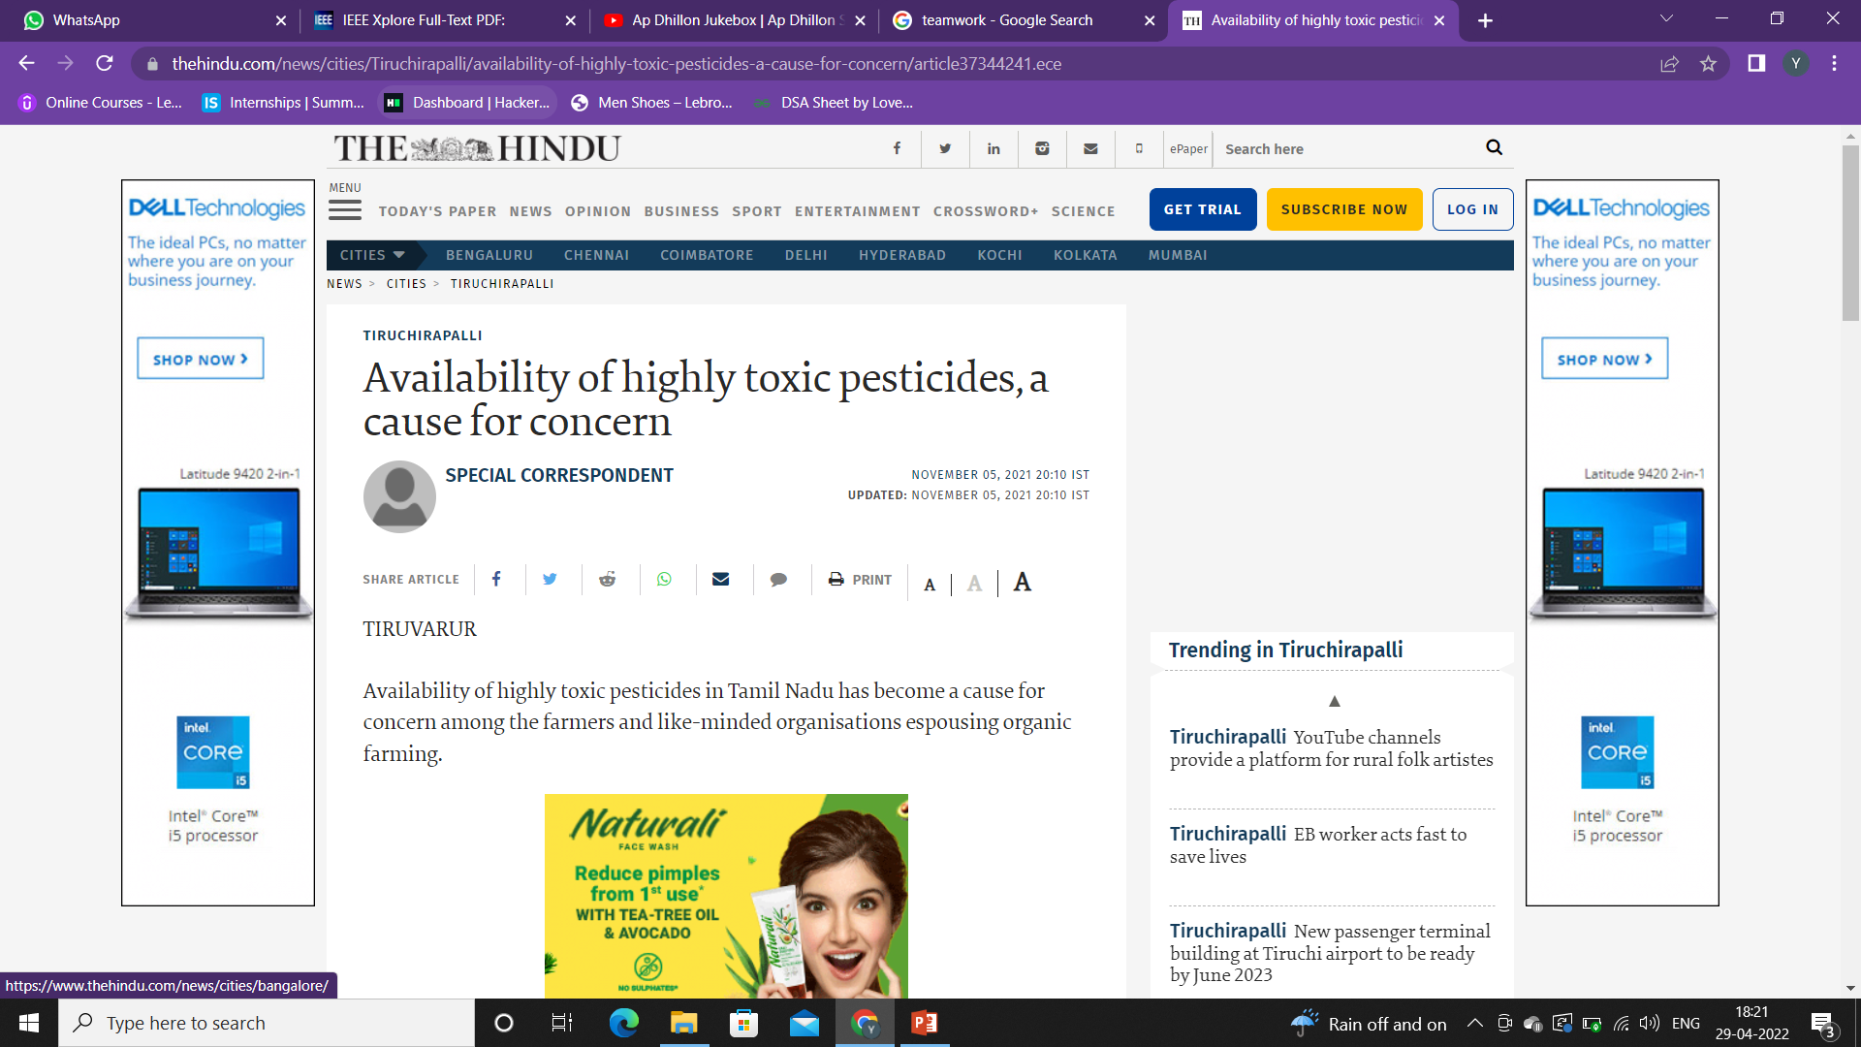
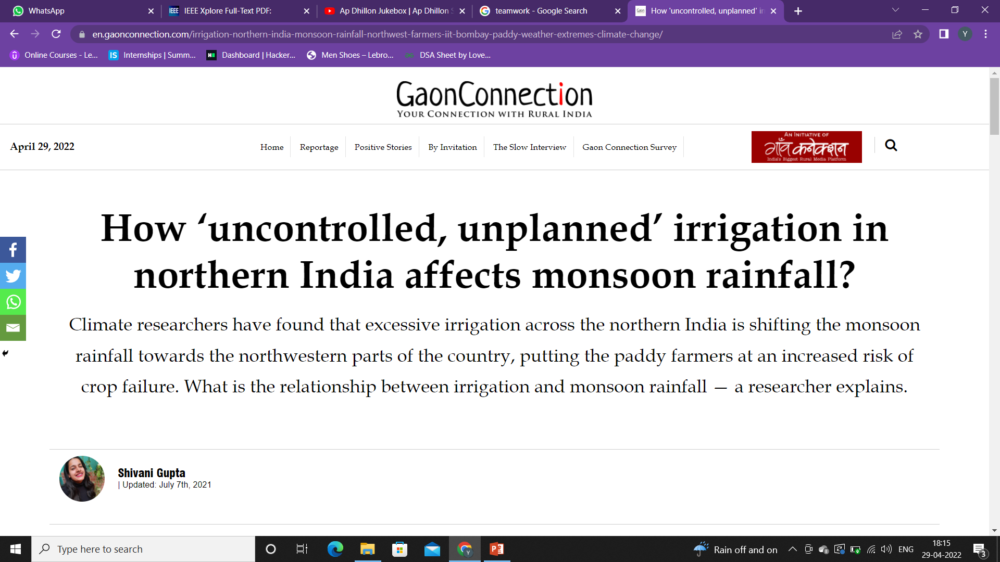
MOTIVATION
The ultimate goal is increasing the quality and quantity of the crops while optimizing the human labour used.

Slide 6
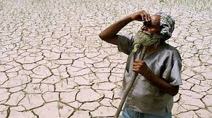
PROBLEM STATEMENT
To provide efficient decision support system using wireless sensor network which handle different activities of farm and gives useful information related to farm.
Information related to Soil moisture, Temperature and Humidity content.

Slide 7
Literature Survey
Author | Title | Software Used | Hardware Used | Advantages
D.Hemanth Kumar, P. Ramesh, Bhavana Godavarthi, P. Nalajala | Design and implementation of modern automated real time monitoring system for agriculture using IOT | ARM module interfaced with sensors, Monitoring the plant through IOT and server. | Temperature sensor, Humidity sensor, ARM controller, Relay driver, Solenoid valve. | An integrated wired/wireless solution allows one to exploit the positive aspects of both technologies and this is handled from any place.
Adithya Vadapalli, Swapna Peravali and Venkata Rao Dadi | Smart Agriculture System using IoT Technology | ___________ | Arduino UNO board, Temperature & Humidity sensor, Raindrop sensor, soil moisture sensor, relay switch on /off the Pump. | With the use of remote sensor frameworks, farmers get the farm conditions while seated at home or in another location.
Nikesh Gondchawar1, Prof. Dr. R. S. Kawitkar2 | IoT based Smart Agriculture | AVR Studio Version 4, Proteus 8 Simulator, Raspbian Operating System, SinaProg | AVR Microcontroller Atmega, ZigBee Module, Temperature Sensor, Moisture sensor, Obstacle sensor, Raspberry Pi | The main feature of this paper is it comprises intelligent decision-making based on exact real-time field data and smart irrigation. Smart warehouse management, which involves monitoring the humidity, temperature, and thefts.

Slide 8
Muthunoori Naresh, P Munaswamy | Smart Agriculture System using IoT Technology | Software Used | ARM Processor, Water level sensor, moisture sensor, humidity sensor, temperature sensor | The invention that evaluates the harvest's nature and offers suggestions.
Prathibha S R1, Anupama Hongal 2, Jyothi M P3 | IOT BASED MONITORING SYSTEM IN SMART AGRICULTURE | ___________ | Temperature sensor, Humidity sensor, 600-W high-efficiency power supply, CC3200 Single chip with integrated microcontroller, Camera | By monitoring the efficiency of the soil, temperature and humidity, rain fall, fertilizer efficiency, monitoring water tank storage capacity, and also detecting theft in agricultural regions, this research expects a rise in output at a cheap cost.
G. Sushanth and S. Sujatha | IOT Based Smart Agriculture System | ___________ | Arduino Uno board, Power supply, moisture sensor, Temperature sensor, Humidity sensor, | For the purpose of controlling water flow, an algorithm was created using temperature and moisture in the soil threshold values that was then put into a microcontroller-based gateway.
Devesh Mishra, Tanuja Pande, Dr. Krishna Kant Agrawal, Akhilesh Kumar Pandey, Prof. Ram Suchit Yadav | Smart Agriculture System Using IOT | Arduino IDE, Blynk, ThinkSpeak, | NodeMCU (ESP8266-12E), Humidity & Temperature Sensor, Soil Moisture Sensor | Parameters from the Soil, moisture Temperature and Humidity has been displayed on the application. Notification of watering the plants according to the value of moisture content measured by soil moisture sensor is also received. The threshold value for activating the pump can also be set accordingly.

Slide 9

Work load distribution and Project planning
Yashwardhan | Yatharth Negi | Aakriti Kumari
Hardware/sensor | Hardware/sensor | Hardware/sensor
Software | Software | Design/Doc

Slide 10
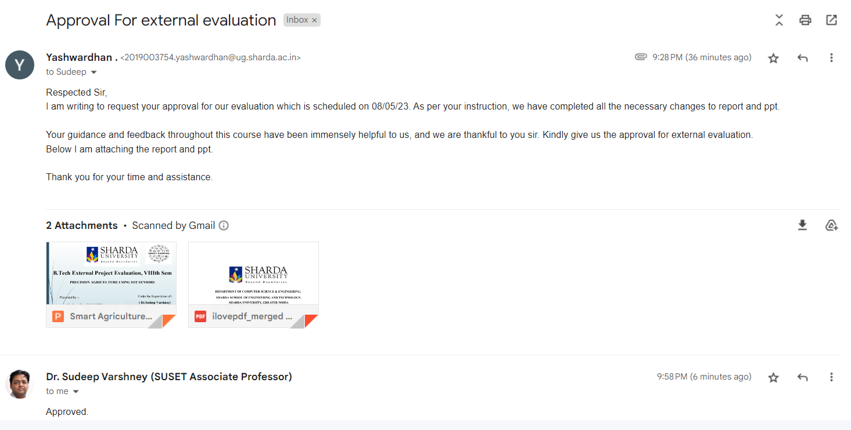
Approval from guide for the evaluation

Slide 11
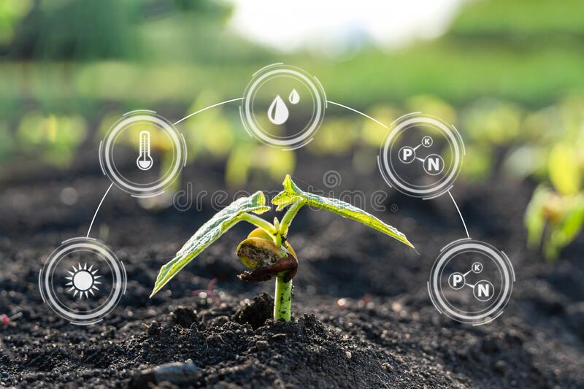
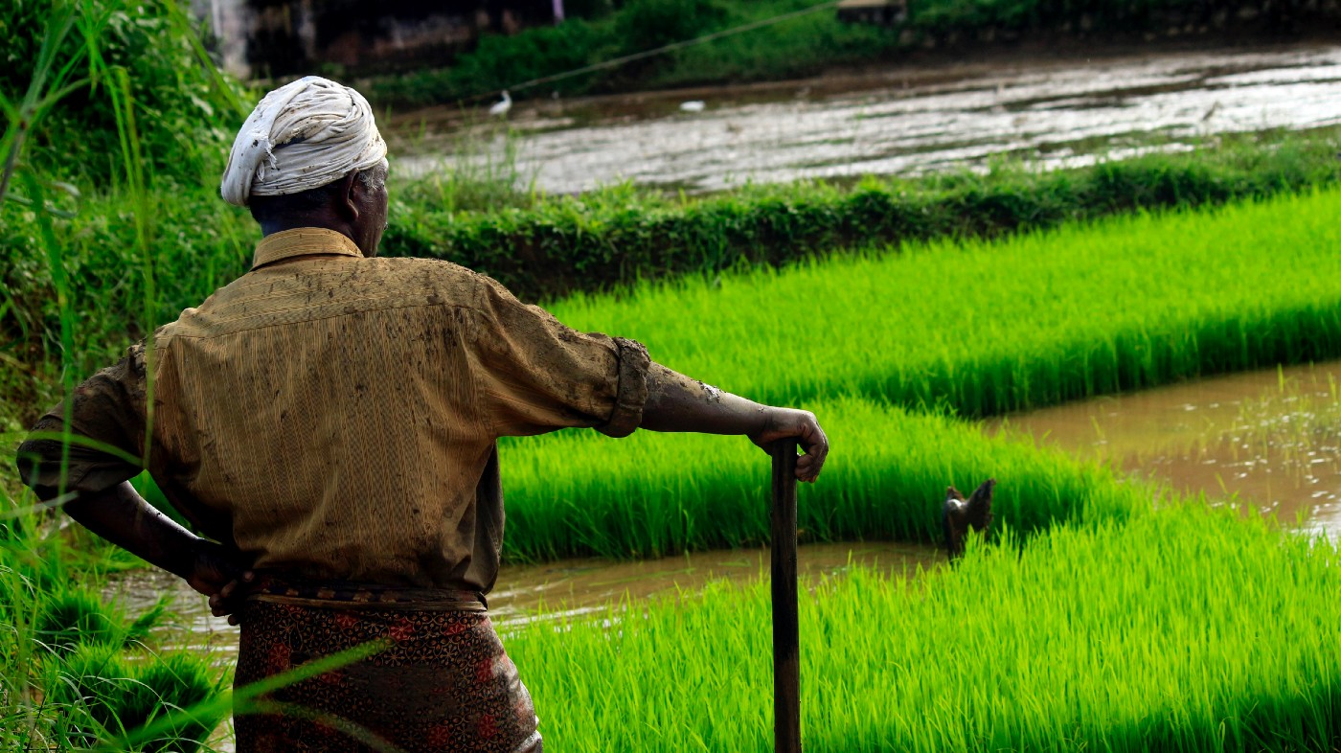
PROJECT MANAGEMENT PLANNING
Cost Analysis
We have identifed all the cost and benefits of carrying out the project and operating the delivered application,
Expressing these cost and benefits in common units
Setup cost for putting the project into use , it include any hardware and ancillary equipment

Slide 12
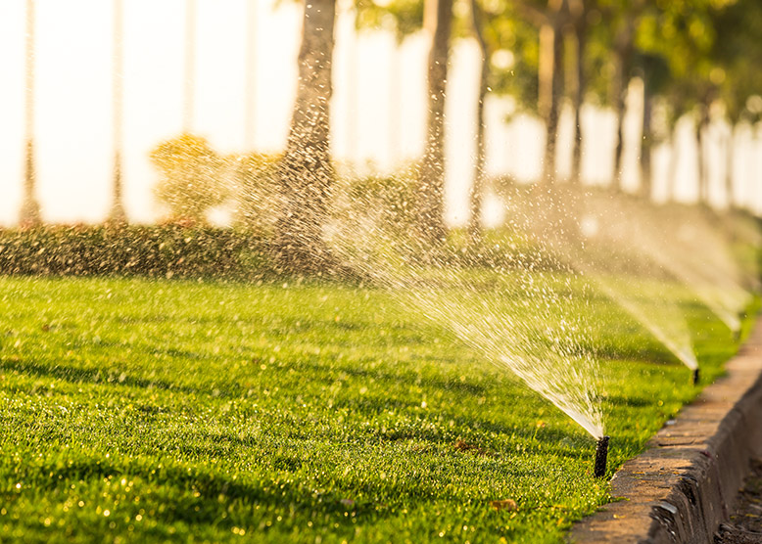
Features of SAS
Water management: Farmers may monitor the water level using their cell phones. The motor will operate automatically as a result of this technology. If the water level drops, the motor automatically turns on, and if the water level is high, the motor will shut down.

Slide 13
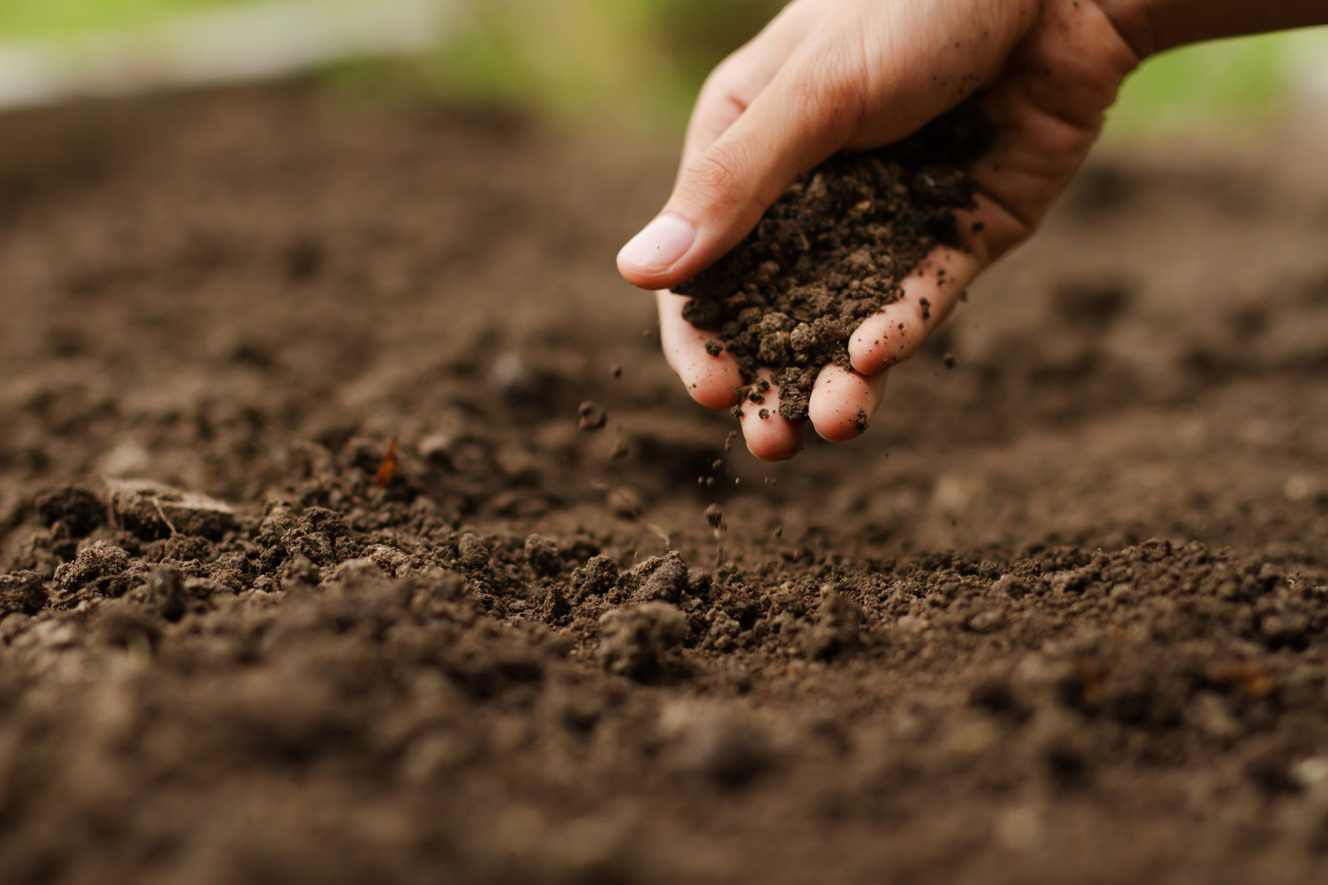
Features of SAS
Soil management: Soil management entails determining various soil parameters such as pH, moisture content, Soil Humidity, Temperature and so on. These parameters can be conveniently monitored using IOT sensors. Farmers will then take measures such as fertilization, drainage, irrigation, and so on. This will assists in the discovery of the right plant breed.

Slide 14
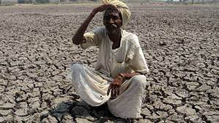
Features of SAS
Weather management: Weather have the greatest impact on crop production. Farmers can decide the best time for planting, irrigation, and harvesting using an IOT-enabled weather forecasting system. Farmers should prepare accordingly and adjust the harvesting and irrigation period to boost the crop based on historical results.

Slide 15
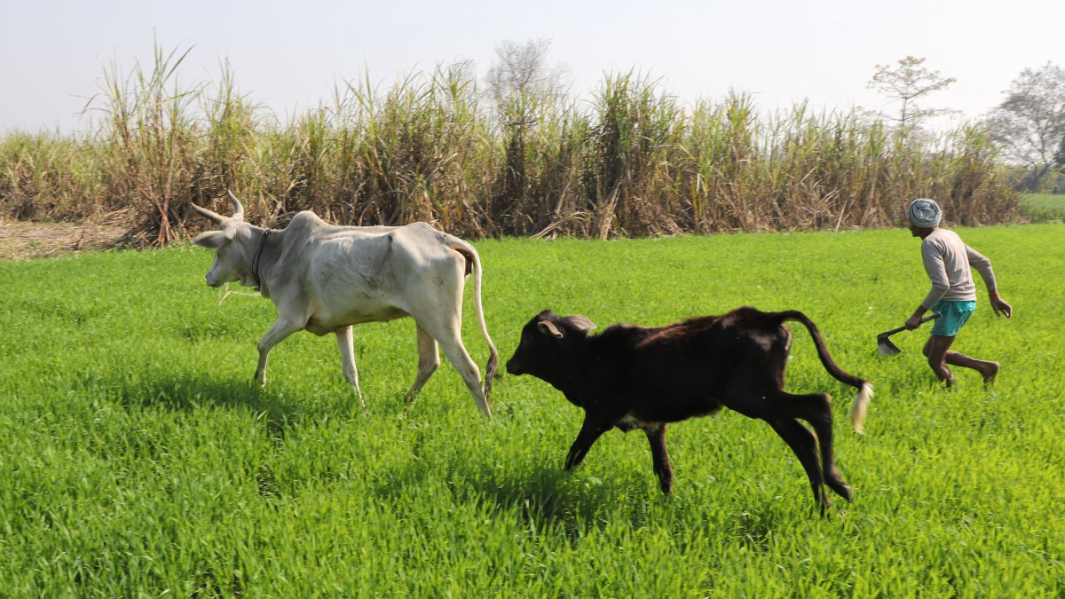
Features of SAS
Animal Intrusion detection: Intrusion of animals especially cows, monkeys, dogs etc to the fields is a very common issue and one of the factors for disruption or disturbance to the yield. This can be overcome by this system which has a motion sensor to detect the presence of any animal in the fields and send notifications to the farmer in their presence

Slide 16
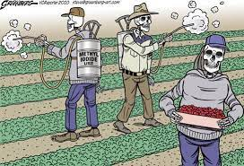
Features of SAS
Usage of UV lights: Pesticide exposures have been linked to many human diseases such as Alzheimer, Parkinson, amyotrophic lateral sclerosis, asthma, bronchitis, infertility etc. We have unique feature of UV light to reduce the usage of pesticides.

Slide 17
Proposed Architecture
Proposed system has three modules –
Farm side
Server side
Client side
It consists of five methods as follows.
1. Sensing local agricultural parameters.
2. Identification of location of sensor and data collection.
3. Transferring data from crop fields for decision making.
4. Decision support and early warming based on data analysis, domain knowledge.
5. Actuation and control based on decision.

Slide 18
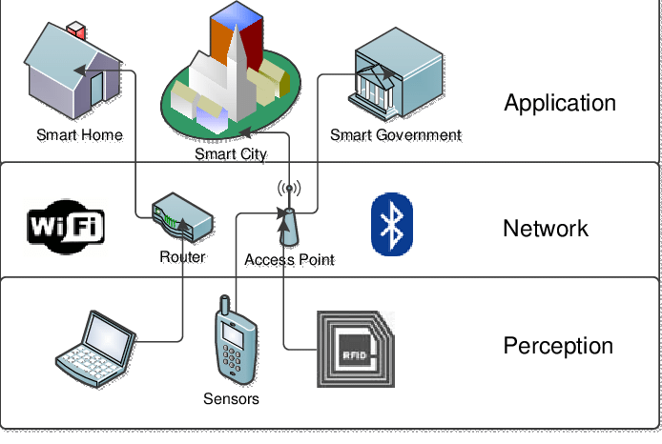
Continued….

Slide 19
Continued….
Perception Layer: This is the first layer in this architecture system. This layer consists of various sensor which sense the physical environment and identifies the other smart objects. Various sensor used in this system are motion sensor, temperature and humidity sensor, moisture sensor etc.
Network layer: This layer is next to perception layer in 3 tier architecture system. This layer is responsible for connecting to other smart devices, networks and servers. Its capabilities are also employed for processing and transferring sensor data.
Application Layer: This is the top layer in 3 tier architecture system. This layer provides the functionality of acting as interface between the IOT devices/sensors and the network with which it will interact. In the application layer, the system can obtain and analyse weather information from the internet, including weather forecast in the previous days.

Slide 20
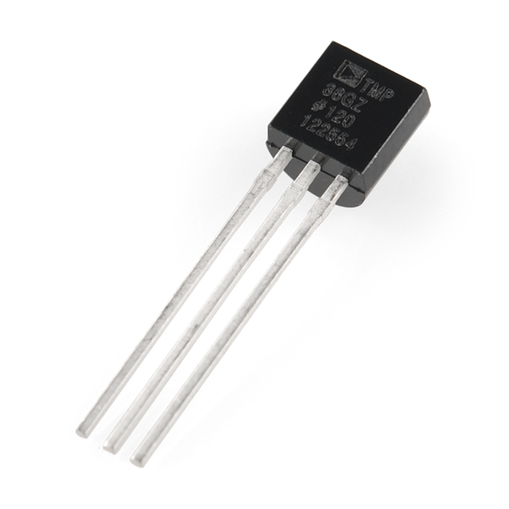
Hardware Used{1}
IC7805: The IC 7805 is a 5V voltage regulator that limits the output voltage to 5V over various input voltage ranges. It acts as an excellent component against input voltage fluctuations in the circuit and adds an extra layer of security to the circuit. It's cheap, readily available, and very commonly used.

Slide 21
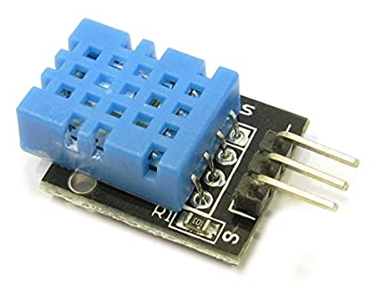
Hardware Used{2}
DHT11: For better crop yield it is important to check all soil parameters. DHT11 sensor is used for temperature and humidity sensing. It outputs both temperature and humidity as serial data. DHT11 sensors can be purchased as sensors or modules. The only difference between sensors and modules is that modules have internal filter capacitors and pull-up resistors, and sensors must use them externally if needed. It has an operating voltage between 3.5V to 5.5V and accuracy of -1% to +1%.

Slide 22
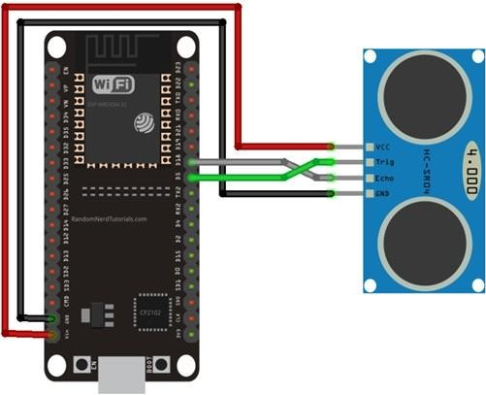
Hardware Used{3}
HC - SR04: In our proposed system, HC - SR04 sensor detects the animal intrusion in the field. The transmitter releases a specially designed 8-pulse pattern. If pulses are reflected back it indicates the presence of obstruction. The distance of obstruction is calculated by multiplying the speed of sound(340m/s) and the time taken by Echo pin to get the reflected pulse.

Slide 23
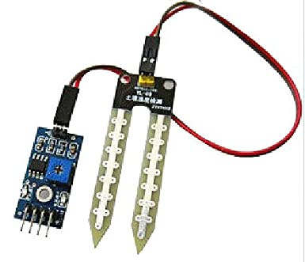
Hardware Used{4}
Moisture Sensor: Soil moisture sensor is a device which senses the current moisture of the soil and can also be used to tell us the amount of water stored in the soil. In order to measure the water content, a fork- shaped analytic device with two exposed conductors is placed into the soil or wherever the water content is to be calculated.

Slide 24
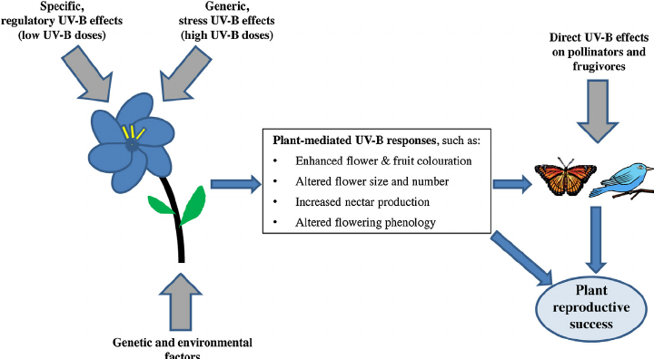
Hardware Used{5}
UV lights: UV light can also help maintain a healthy growing environment by reducing mold, mildew, and certain plant pests - all of which need alternatives to chemicals due to increasing fungicidal resistance. It has also been shown to have antimicrobial effects including dealing with agricultural infections and pests, such as powdery mildew or spider mites; as well as triggering plant

Slide 25
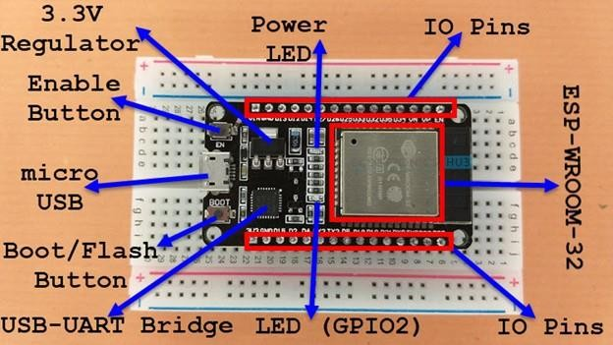
Hardware Used{6}
ESP32: We have used a more powerful microcontroller than arduino i.e ESP32. The Arduino falls short in many areas despite its great assets. Arduino has clock speed of around 16Mhz whereas ESP32 has up to 240Mhz.It has 520 KB SRAM, 448KB ROM, and 16KB RTC SRAM. It also supports 802.11 b/g/n Wi-Fi connections at speeds up to 150Mbps.

Slide 26
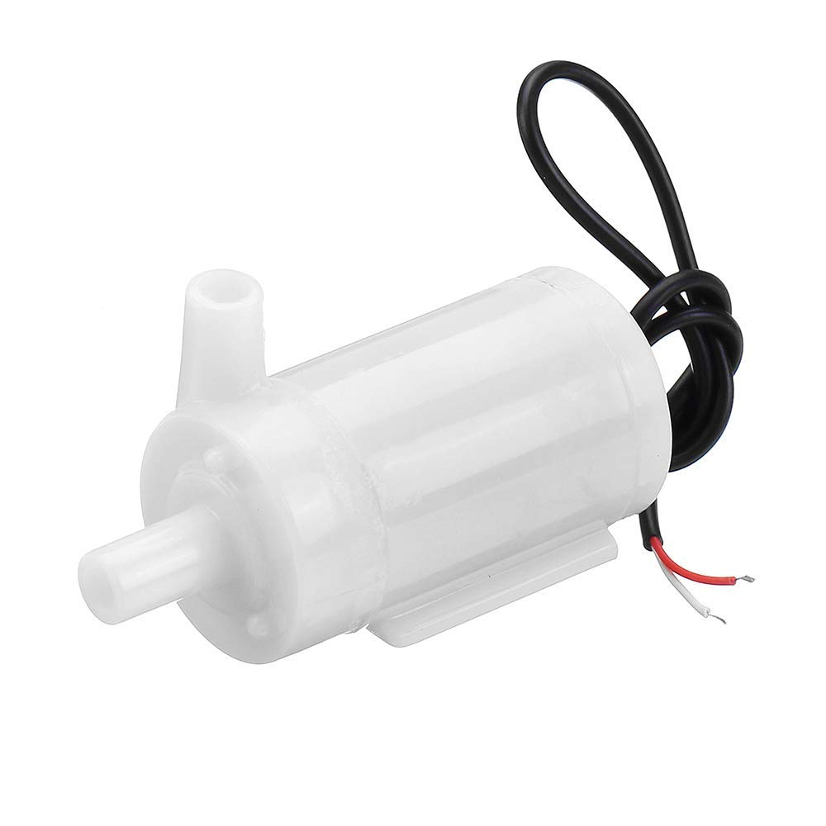
Hardware Used{7}
Water pump: The DC 3-6 V Mini Micro Submersible Water Pump is a low cost, small size Submersible Pump Motor. It operates from a 2.5 ~ 6V power supply. It can take up to 120 liters per hour with a very low current consumption of 220mA. Just connect the tube pipe to the motor outlet, submerge it in water, and power it.

Slide 27
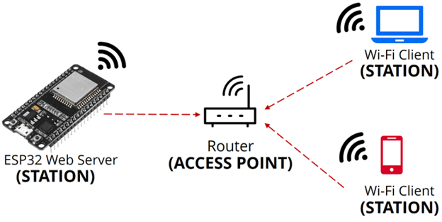
Working
The project works on the bases of esp32 the iot module, works on 3.3V to 5V, ic7805 is an voltage converter ic which is used to convert 12V to 5V, the AC power supply is directly passed to step down transformer, which is connected to rectifier circuit of 4 PN junction diodes which is used to convert the alternating current to direct current, more over the 470uf capacitor is further connected to the terminals for smoothing of voltage, now the 12v dc current is converted into 5v via the ic7805, and the output of 5v is acquired

Slide 28
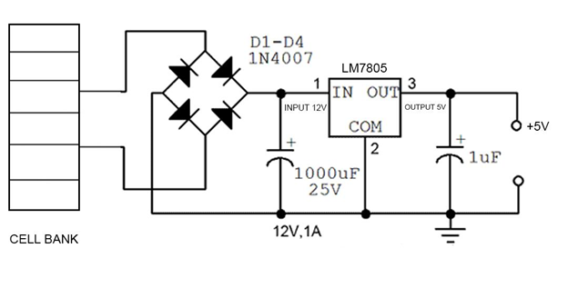
Continued…
The 5V activates the esp32 and all the other sensors connected to the esp32, esp32 is the iot module used to communicate with router and web application, sensors are connected to the digital and analog pins accordingly and sends the data, esp32 creates local page which can be accessed by the every device which is connected to the router.

Slide 29
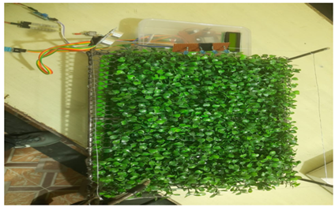
Results
As shown in the figure, the experimental setup for the smart agriculture system in which the various sensors such as motion sensor, soil moisture sensor (HC - SR04), humidity sensor and temperature sensor (DHT11) are connected to the microcontroller board (ESP32).The sensors will be fetching near real time data from the environment and sending it to the controller.

Slide 30
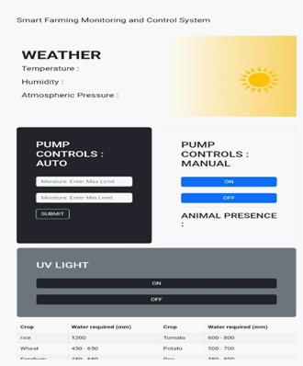
Continued…
In figure below the webpage has been developed which will be interfaced with the system in which the necessary information regarding the moisture content, temperature, fertilizers suggestion for the crops has been mentioned, by this the user will get a fair idea about setting up of threshold value. This interface will be used to turn ON/OFF the uv light from a remote location. It will also provide us with the weather forecast feature

Slide 31
Reference
https://www.fao.org/india/fao-in-india/india-at-a-glance/en/
https://www.fao.org/3/s2022e/s2022e02.htm
Sushanth, G., & Sujatha, S. (2018, March). IOT based smart agriculture system. In 2018 International Conference on Wireless Communications, Signal Processing and Networking (WiSPNET) (pp. 1-4). IEEE.
Abhiram, M. S. D., Kuppili, J., & Manga, N. A. (2020, February). Smart farming system using IoT for efficient crop growth. In 2020 IEEE International Students' Conference on Electrical, Electronics and Computer Science (SCEECS) (pp. 1-4). IEEE.
Patil, K. A., & Kale, N. R. (2016, December). A model for smart agriculture using IoT. In 2016 international conference on global trends in signal processing, information computing and communication (ICGTSPICC) (pp. 543-545). IEEE.
Naresh, M., & Munaswamy, P. (2019). Smart agriculture system using IOT technology. International Journal of Recent Technology and Engineering, 7(5), 98-102.

Slide 32
Abirami, G., Helan, R. R. H., Geetha, P., & Thamizharasi, M. SMART AGRICULTURE SYSTEM.
Sinha, B. B., & Dhanalakshmi, R. (2022). Recent advancements and challenges of Internet of Things in smart agriculture: A survey. Future Generation Computer Systems, 126, 169-184.
Boursianis, A. D., Papadopoulou, M. S., Diamantoulakis, P., Liopa-Tsakalidi, A., Barouchas, P., Salahas, G., ... & Goudos, S. K. (2022). Internet of things (IoT) and agricultural unmanned aerial vehicles (UAVs) in smart farming: A comprehensive review. Internet of Things, 18, 100187.
Salim, S. A., Amin, M. R., Rahman, M. S., Arafat, M. Y., & Khan, R. (2021, September). An IoT-based smart agriculture system with locust prevention and data prediction. In 2021 8th International Conference on Information Technology, Computer and Electrical Engineering (ICITACEE) (pp. 201-206). IEEE.
Krishna, K. L., Silver, O., Malende, W. F., & Anuradha, K. (2017, February). Internet of Things application for implementation of smart agriculture system. In 2017 International Conference on I-SMAC (IoT in Social, Mobile, Analytics and Cloud)(I-SMAC) (pp. 54-59). IEEE.
Mishra, D., Pande, T., Agrawal, K. K., Abbas, A., Pandey, A. K., & Yadav, R. S. (2019, June). Smart agriculture system using IoT.

Slide 33
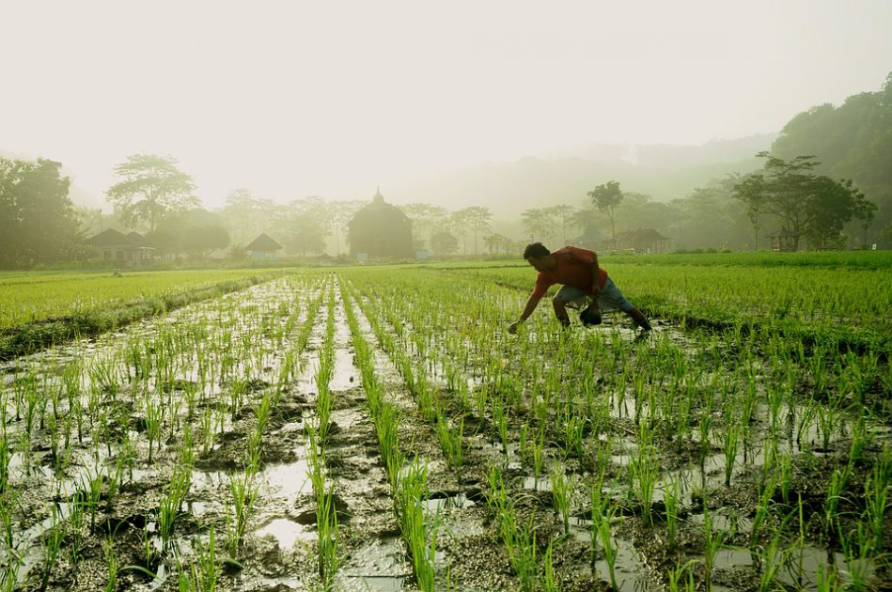
THANK YOU

